Slide 1
Ground Track Tool
Nicholas Delurgio

Slide 2
Code Architecture
groundTrack.m
Function with 10-dimensional input vector
Outputs are latitude, longitude, r_{IJK}, r_{ECEF}, Azimuth, Elevation
groundTrackVizualize.m
Script that initializes initial conditions for orbit
Calls groundTrack.m to obtain solutions
Generates plots to visualize the solutions

Slide 3
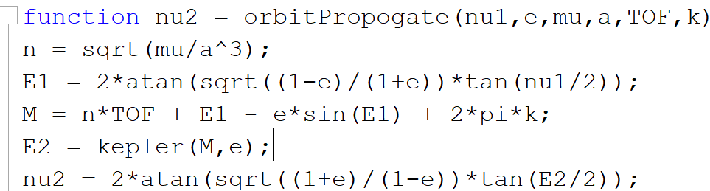
r_{ijk} & r_{ECEF} Trajectory
orbitPropogate.m: function (developed in Mars project) that outputs true anomaly for a given time of flight.
Used in a for loop to create true anomaly values for each point in orbit
Convert orbital elements & true anomaly values to state vector to get r_{ijk} trajectory
Multiply r_{ijk} by an R3 rotation matrix to get r_{ECEF} trajectory
Input to R3 is Greenwich Sidereal Time (ωt+ϴ_{g0}), where ω is the rotation rate of the earth
Therefore, R3 input changes with each for loop iteration
Each trajectory plotted with an Earth-sized sphere object at the origin

Slide 4
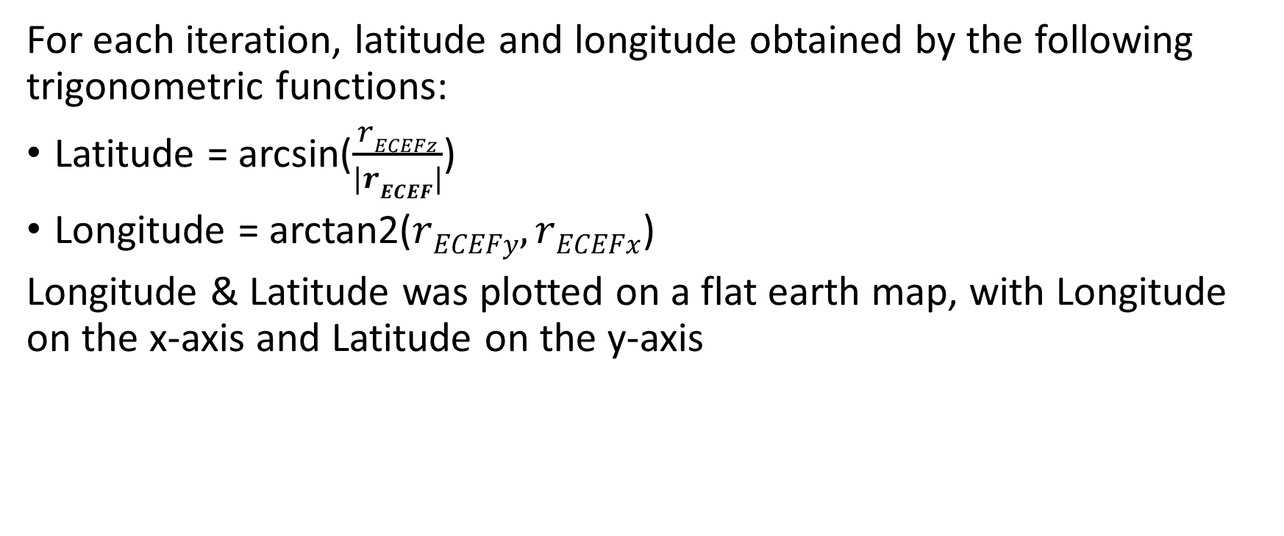
Ground Track
For each iteration, latitude and longitude obtained by the following trigonometric functions:
Latitude = arcsin($\frac{rECEFz}{|rECEF|}$)
Longitude = arctan2($rECEFy,rECEFx$)
Longitude & Latitude was plotted on a flat earth map, with Longitude on the x-axis and Latitude on the y-axis

Slide 5
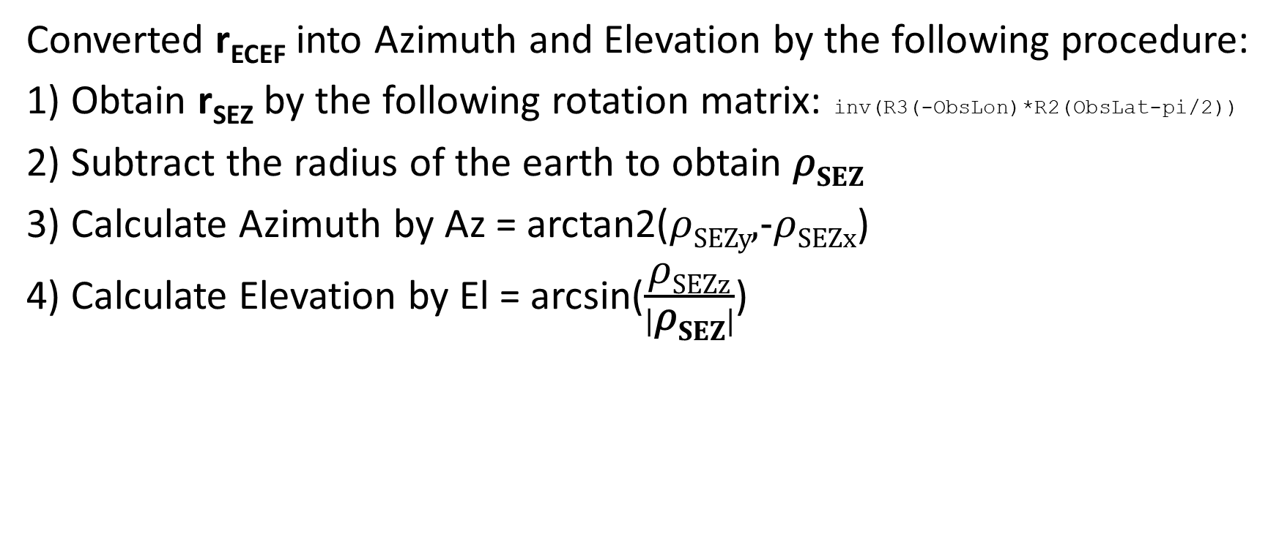
Azimuth & Elevation
Converted r_{ECEF} into Azimuth and Elevation by the following procedure:
1) Obtain r_{SEZ} by the following rotation matrix: inv(R3(-ObsLon)*R2(ObsLat-pi/2))
2) Subtract the radius of the earth to obtain 𝜌_{SEZ}
3) Calculate Azimuth by Az = arctan2(𝜌_{SEZy},-𝜌_{SEZx})
4) Calculate Elevation by El = arcsin($\frac{\text{ρ}\text{SEZz}}{|\text{ρ}\text{SEZ}|}$)

Slide 6
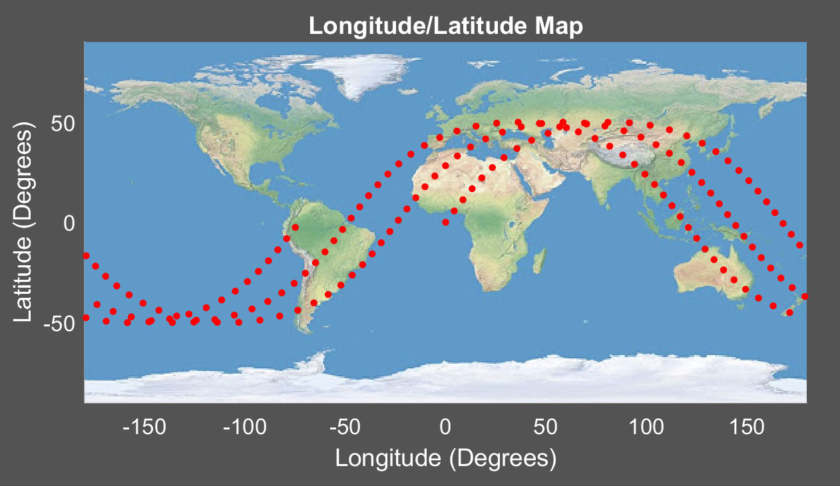
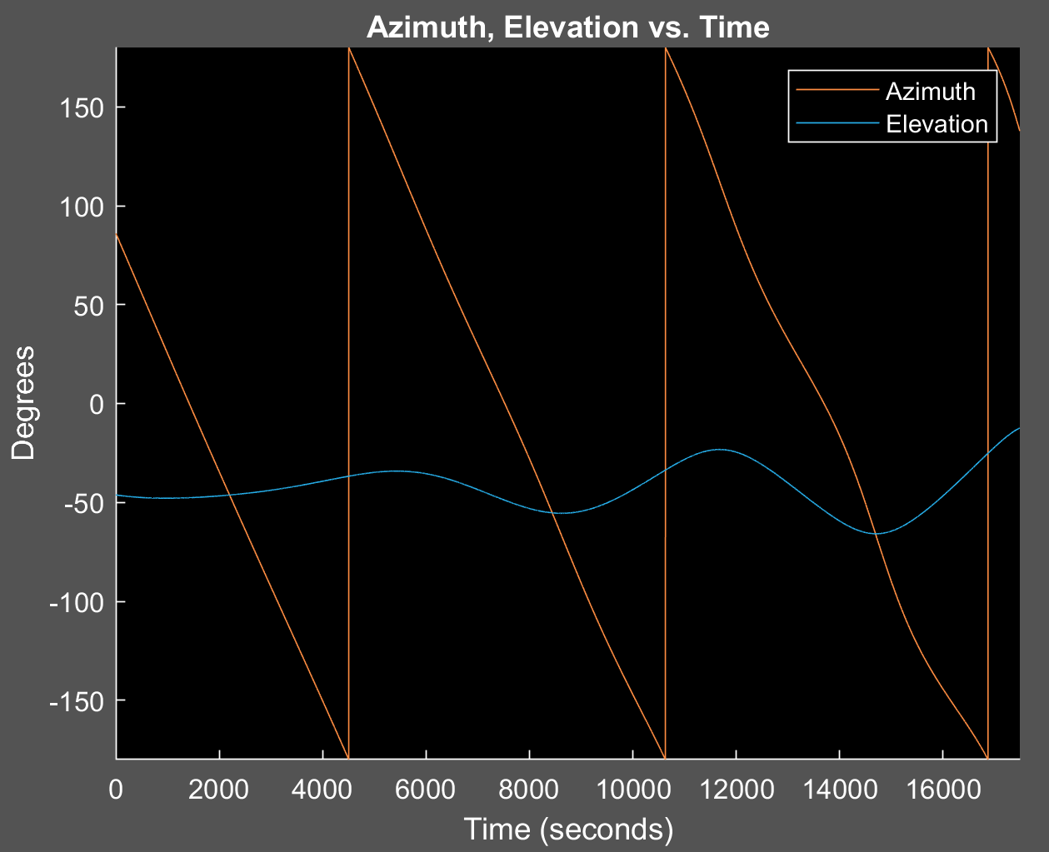
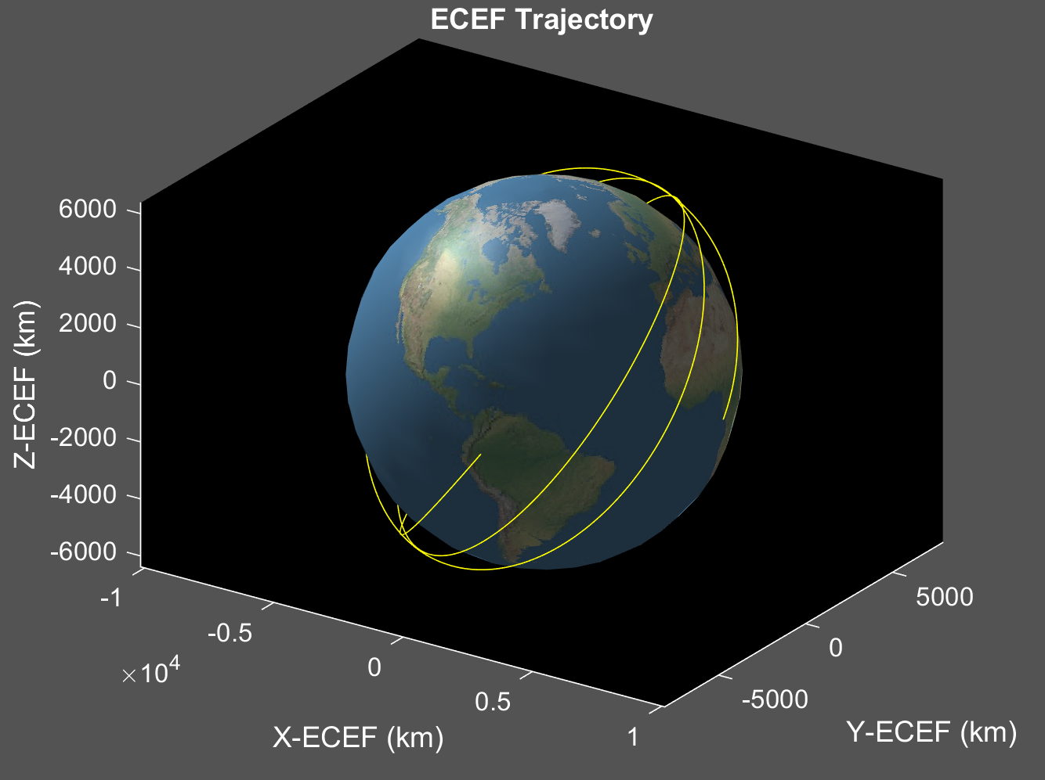
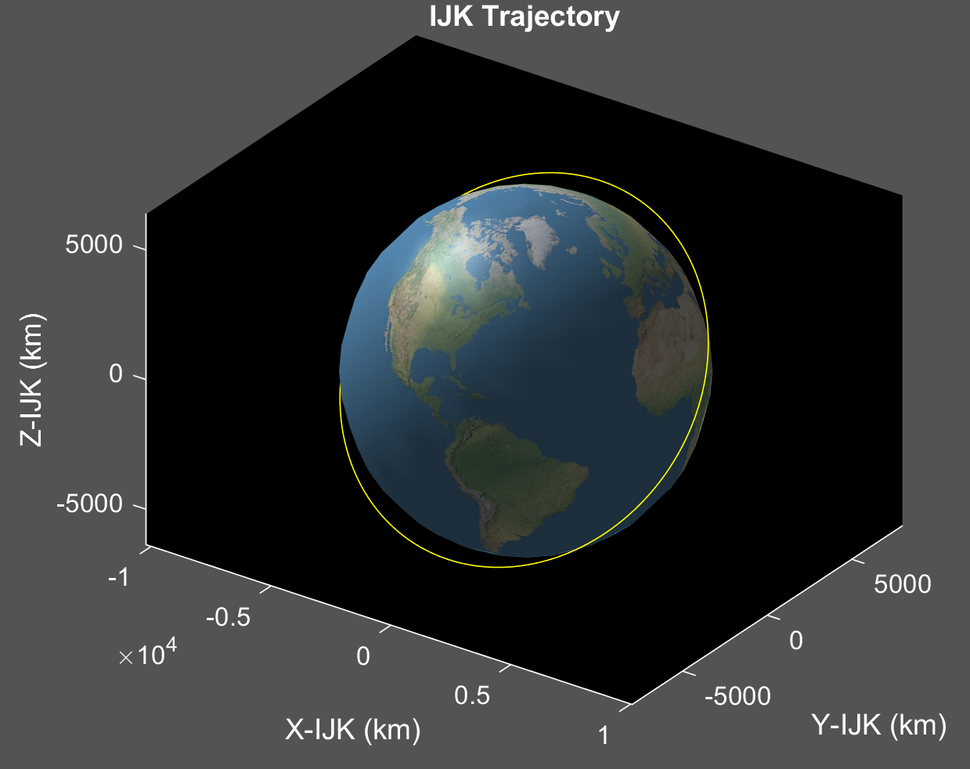
a) [a e i ω Ω ν] = [7000 0.01 50 0 0 0]
Low eccentricity means that ground track speed is fairly consistent, seen by near-equal spacing between dots
Inclination gives spacecraft good coverage for most of the earth’s population
Travels east on map because inclination is less than 90 degrees

Slide 7
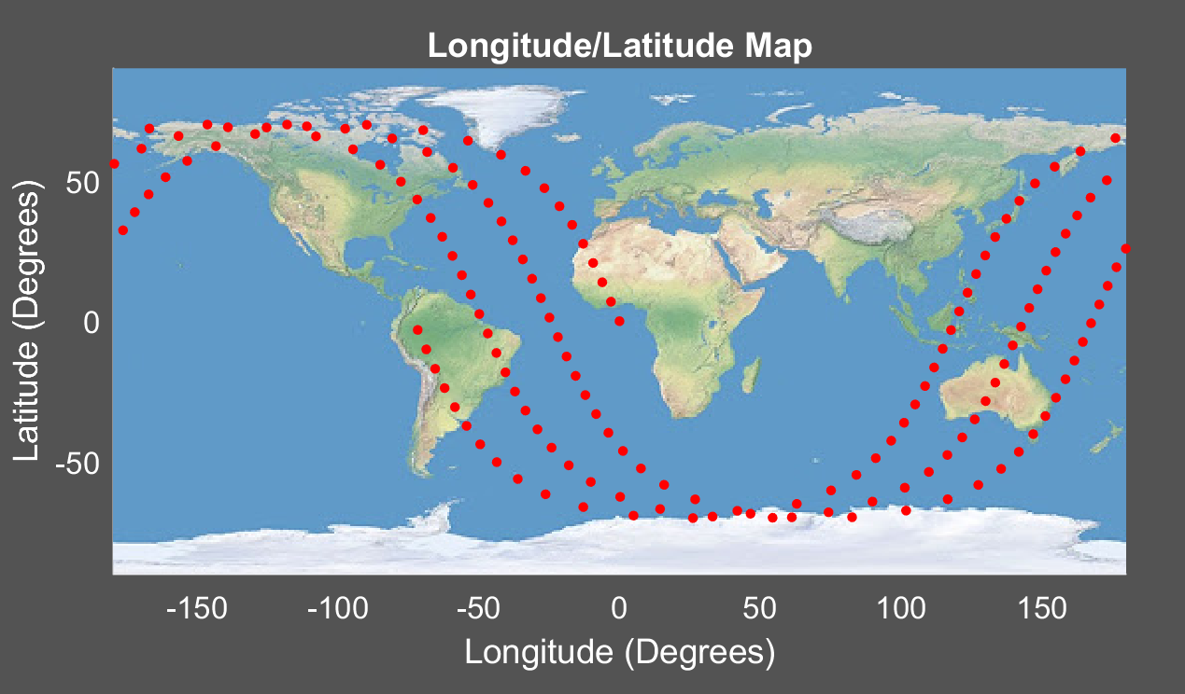
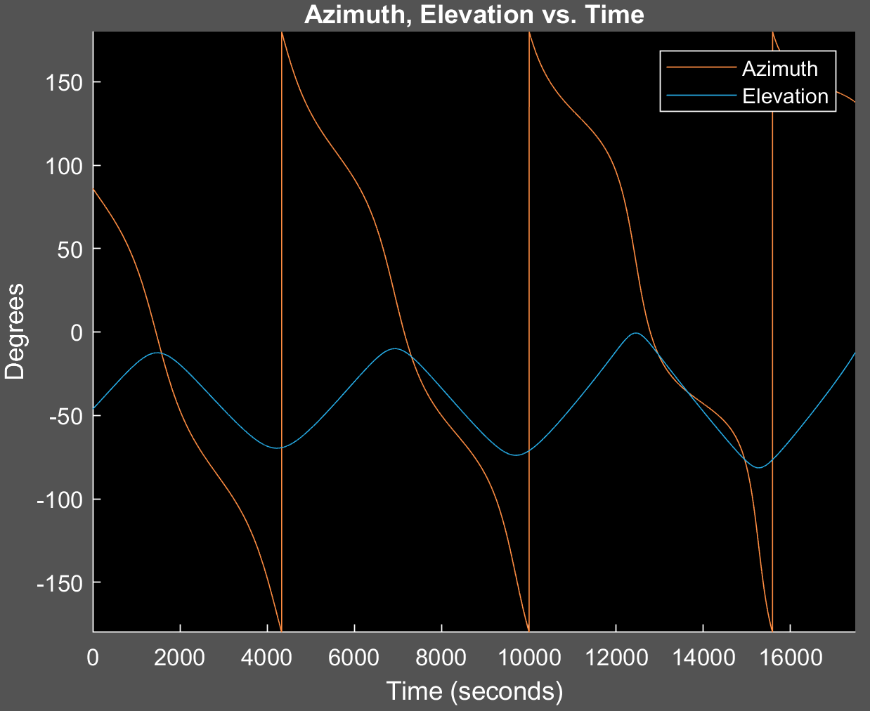
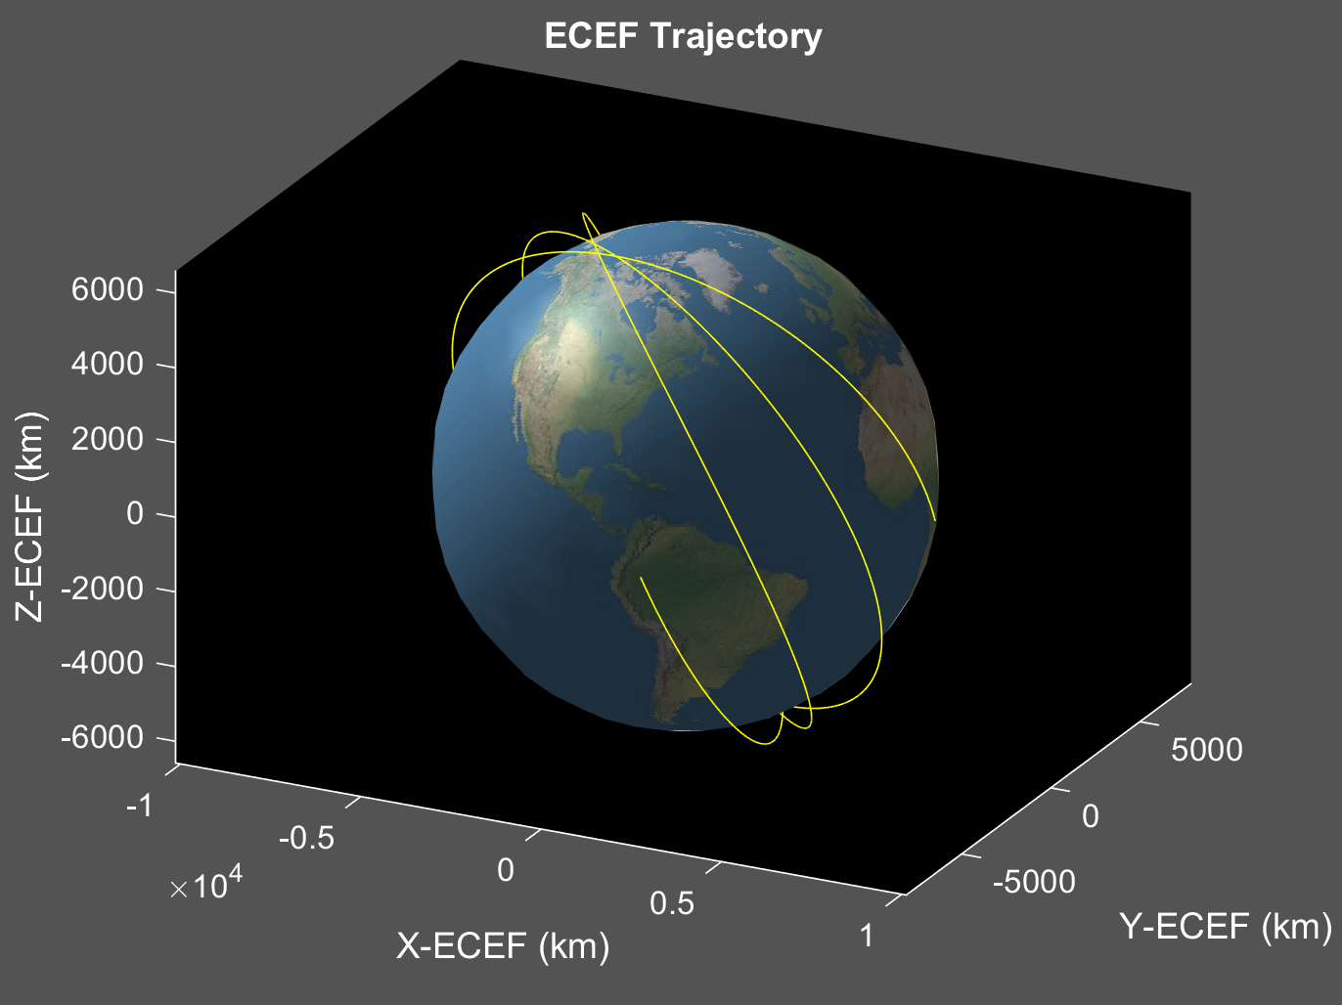
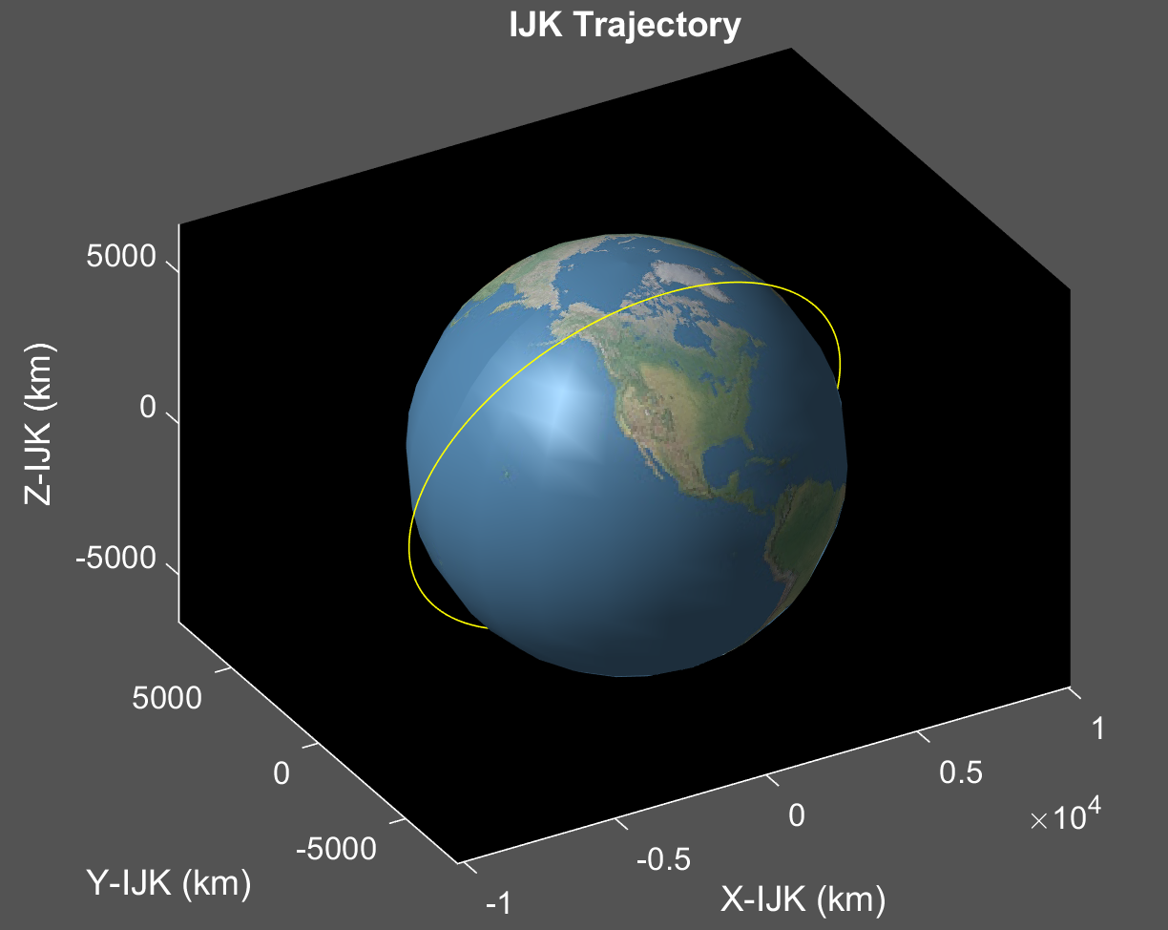
b) [a e i ω Ω ν] = [7000 0.01 110 0 0 0]
Inclination greater than previous scenario, resulting in coverage of greater latitude ranges
Travels west on map since inclination is above 90 degrees
Spacing between dots still relatively equal, and similar to the previous problem
Same altitude

Slide 8
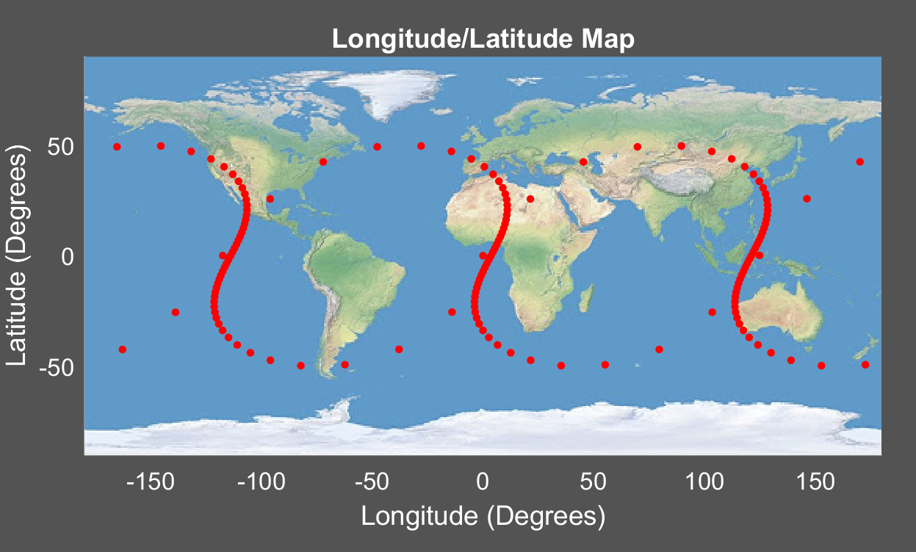
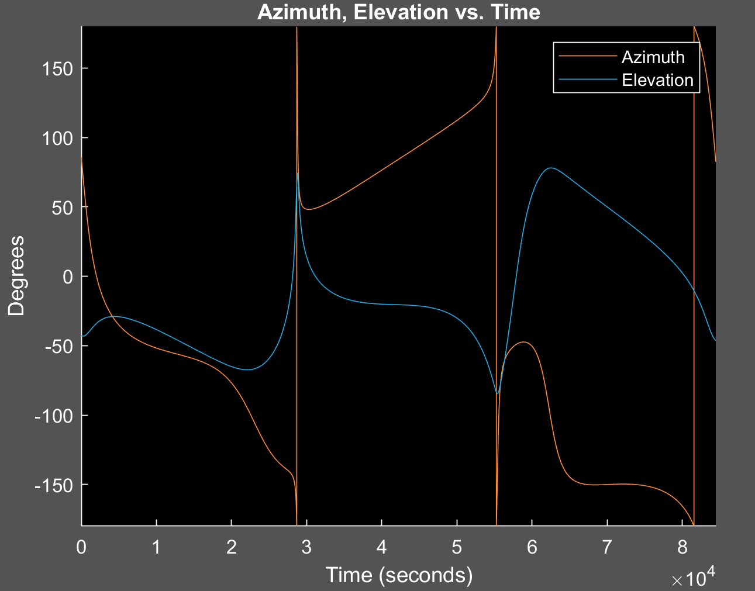
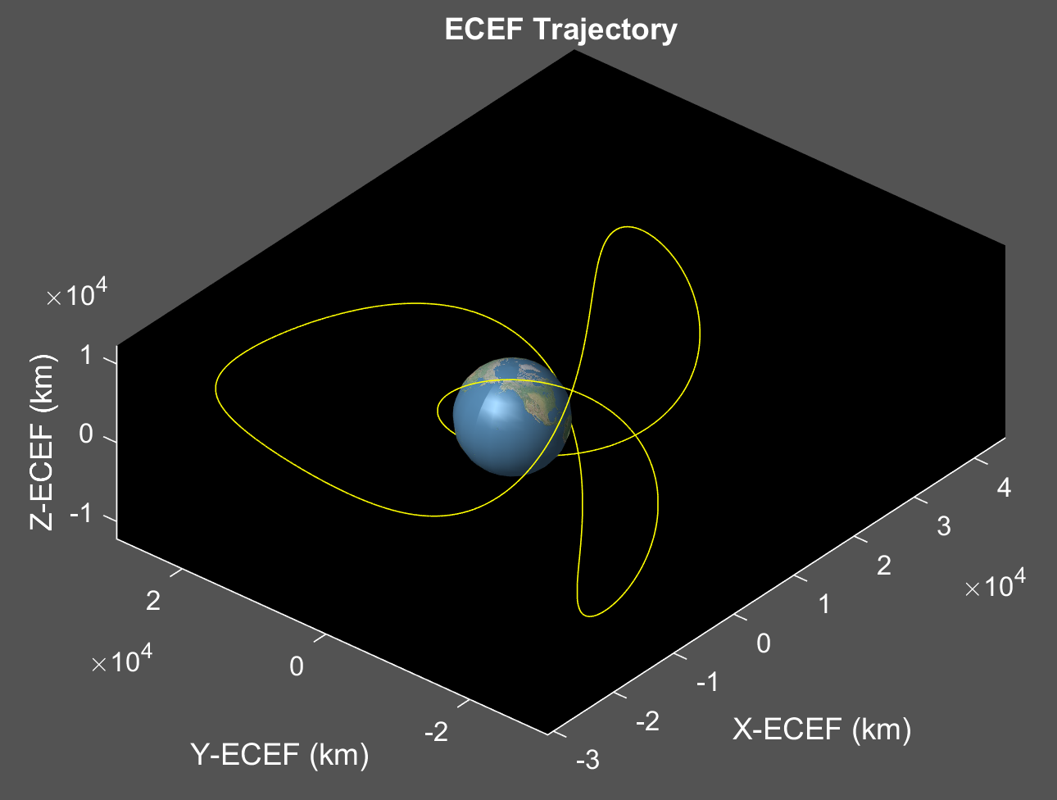
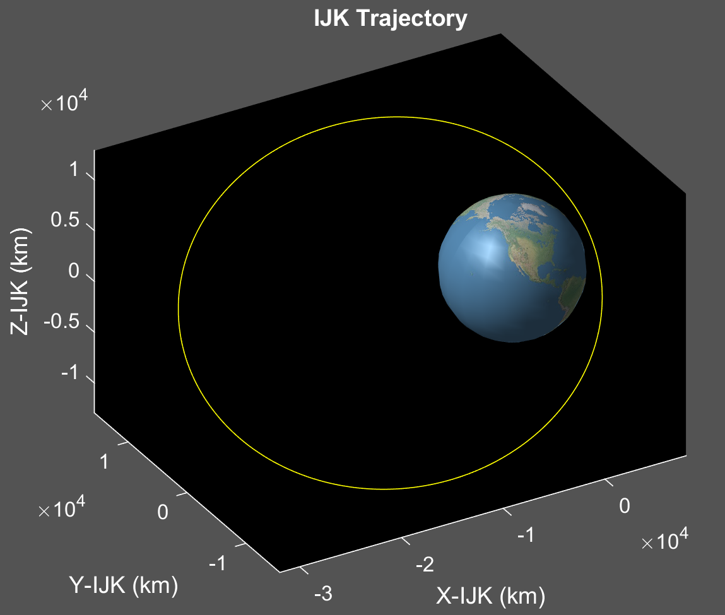
c) [a e i ω Ω ν] = [20000 0.6 50 0 0 0]
High eccentricity, ground track speed varies greatly
Spacing between dots unequal
Inclination is same as (a), meaning range of coverage is similar
Travels east
Larger altitude means minimum spacing of dots is much smaller than previous problems
Pattern close to repeating every three orbits

Slide 9
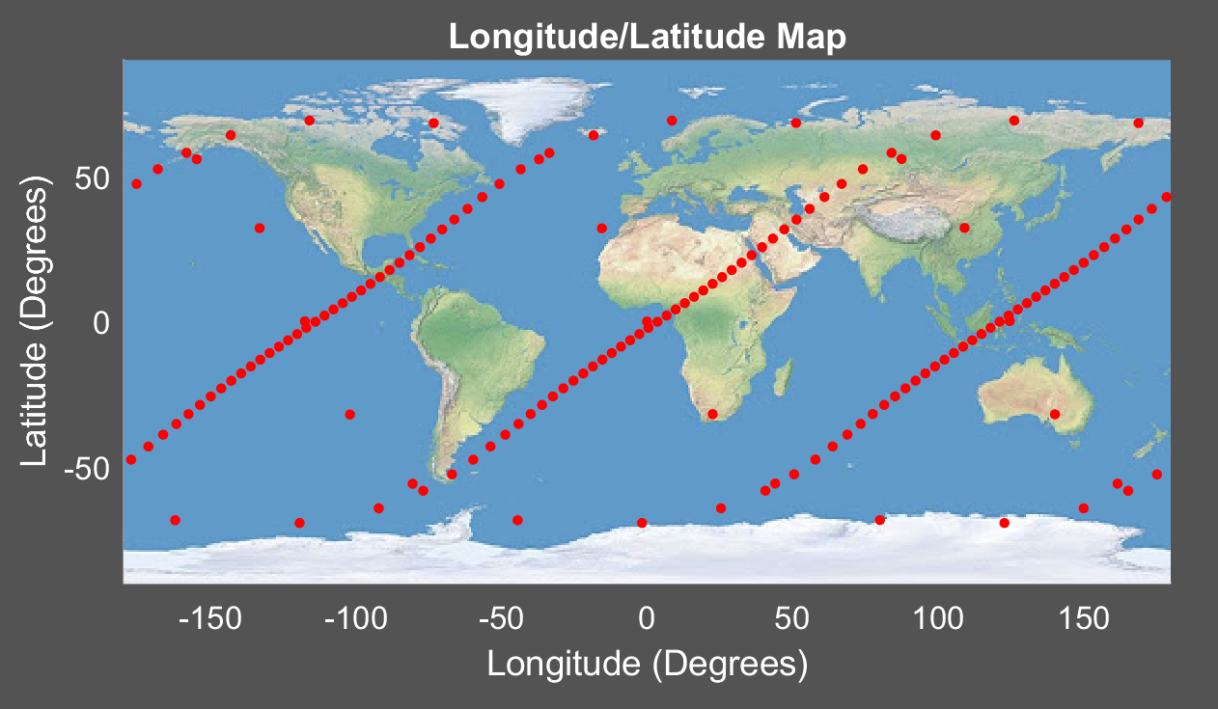
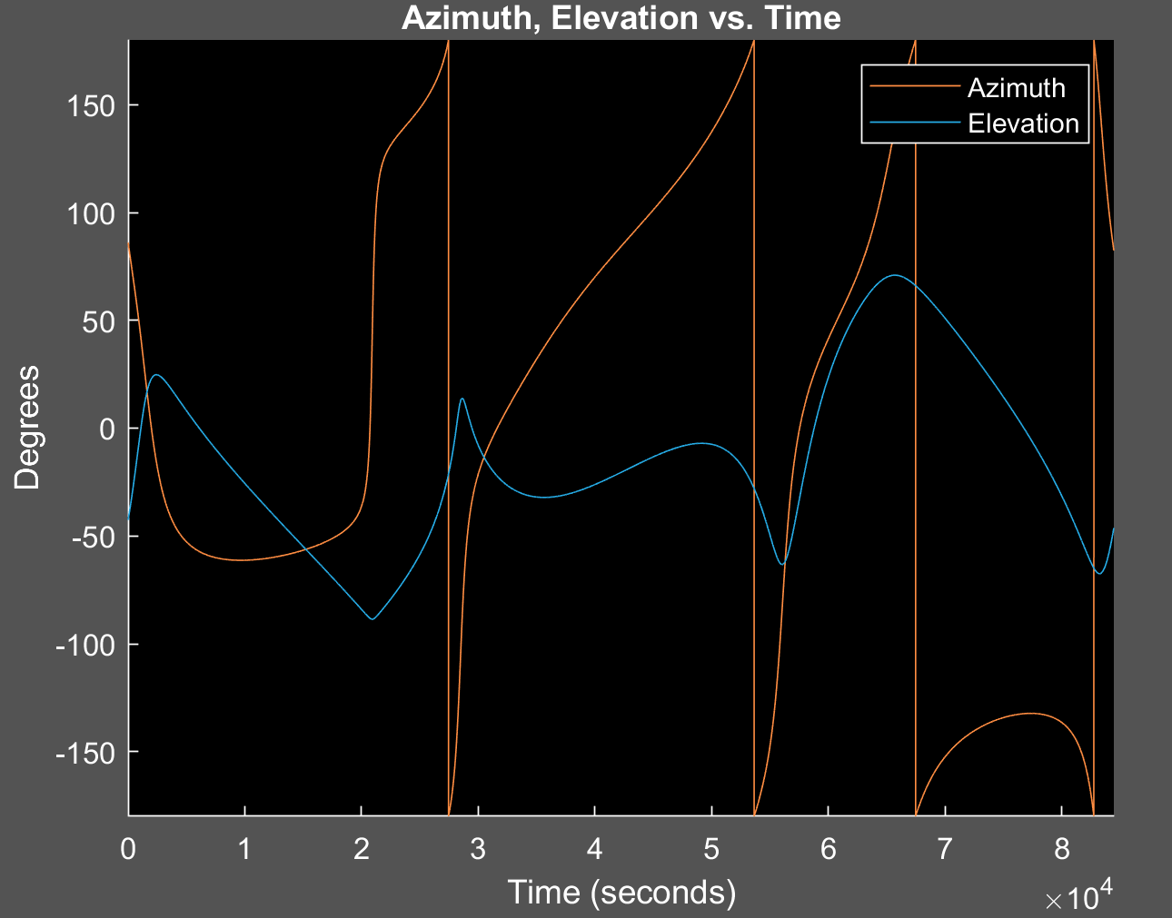
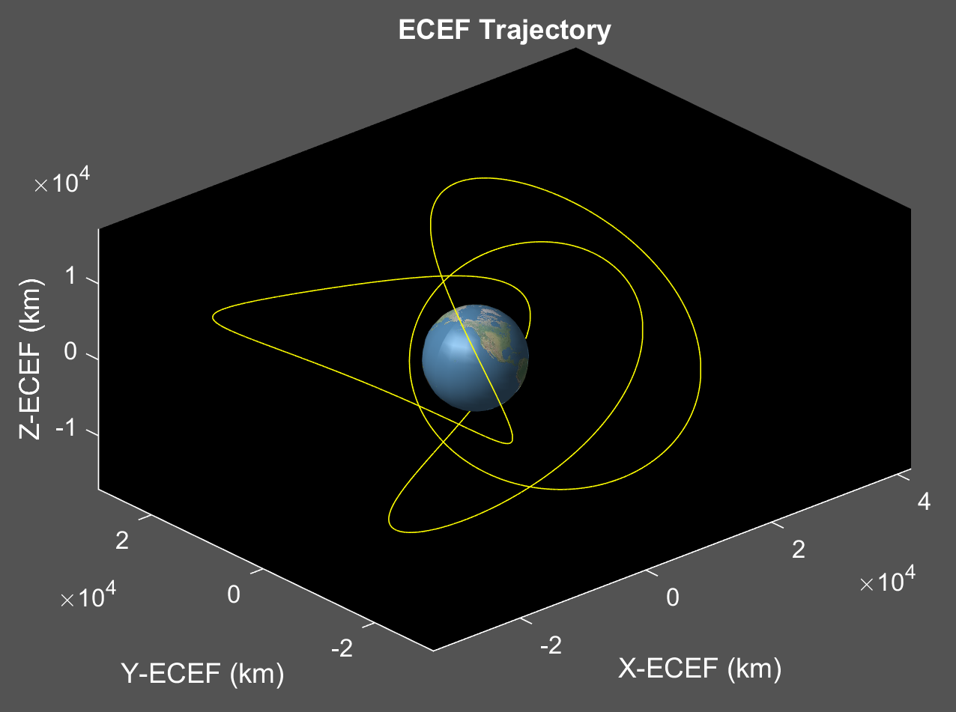
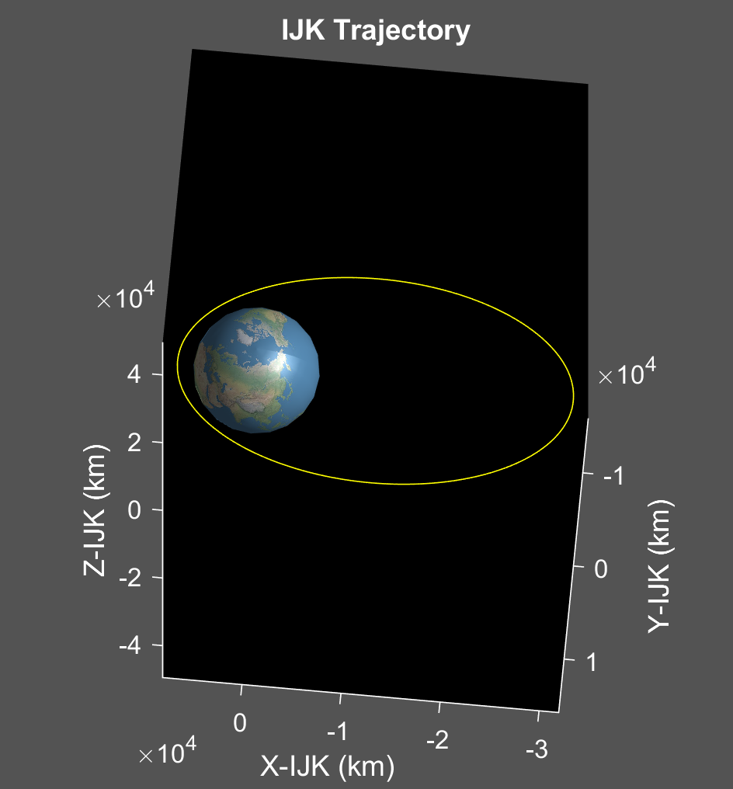
d) [a e i ω Ω ν] = [20000 0.6 110 0 0 0]
High eccentricity leads to large variation in dot spacings
Inclination greater than (c), meaning the range of coverage is greater
Travels west on map
Patter close to repeating every three orbits

Slide 10
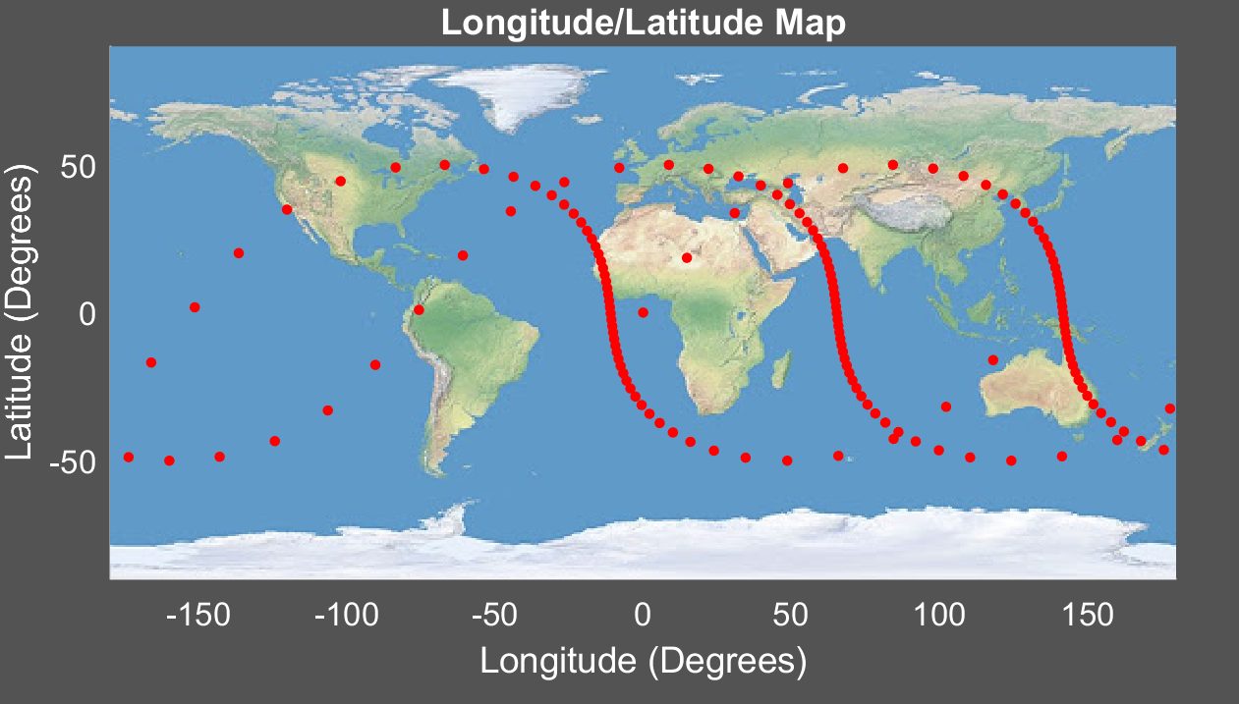
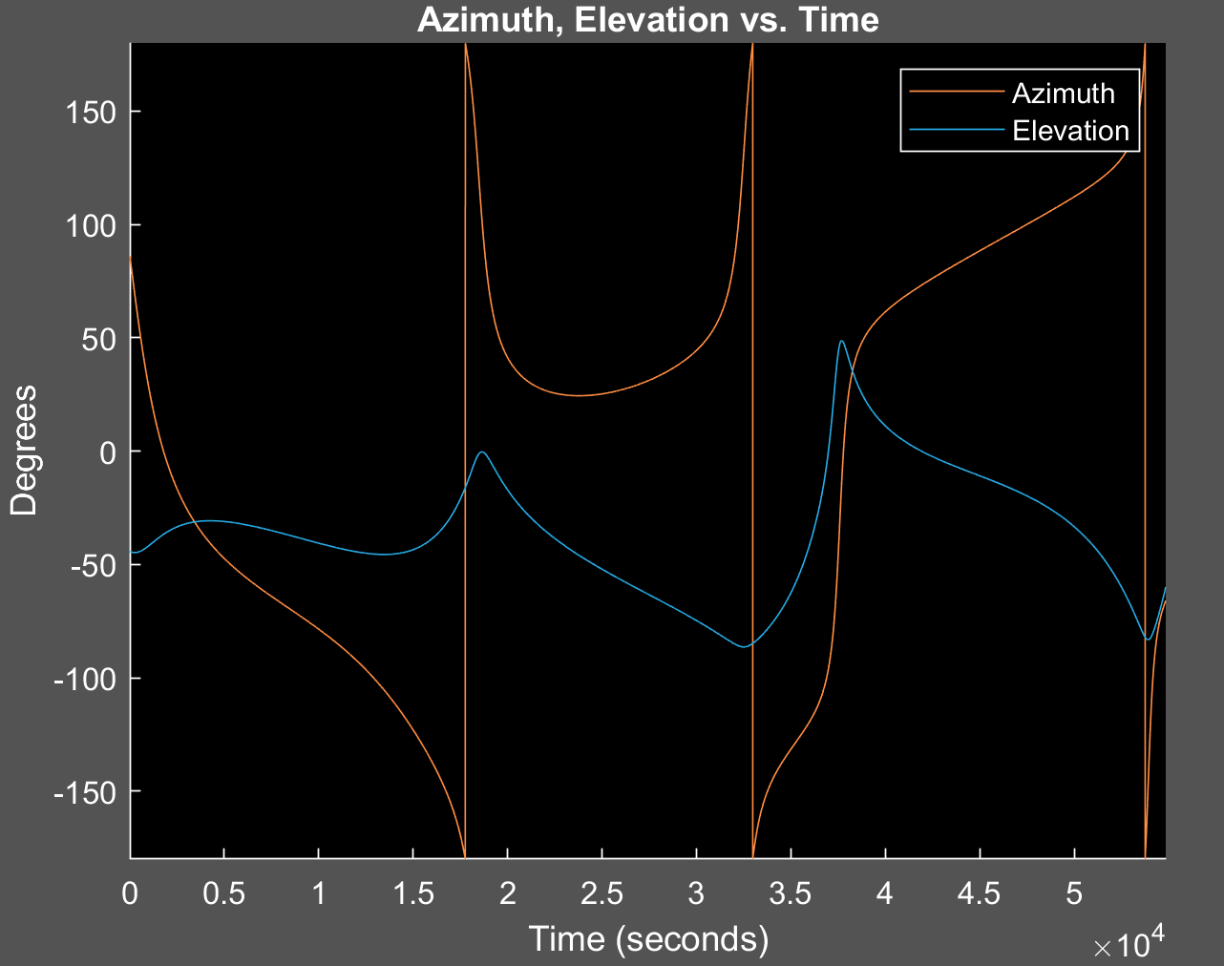
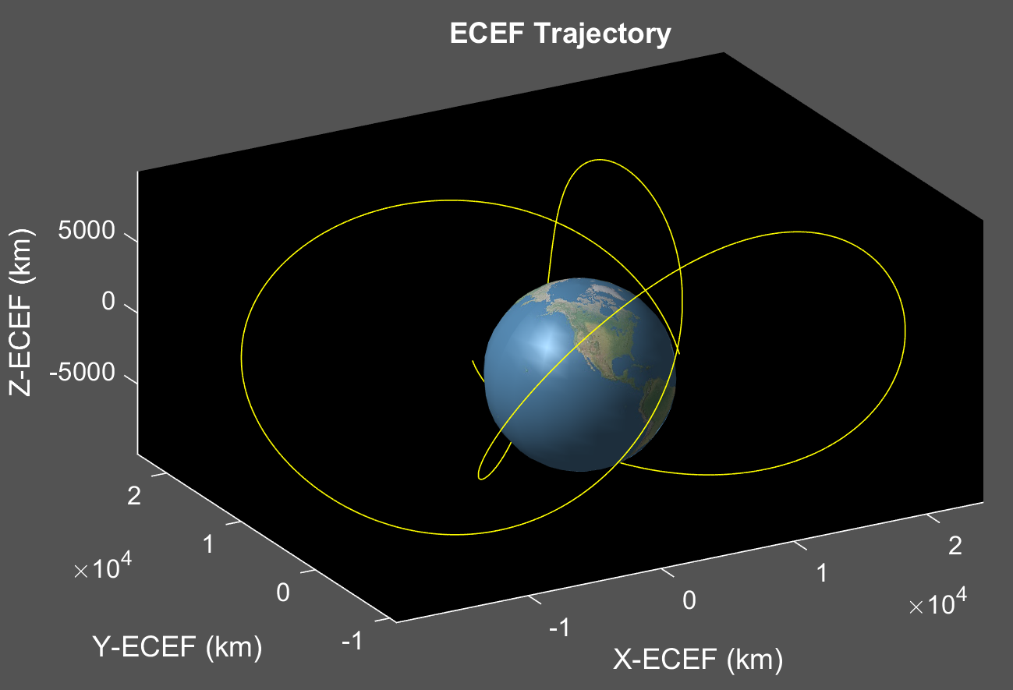
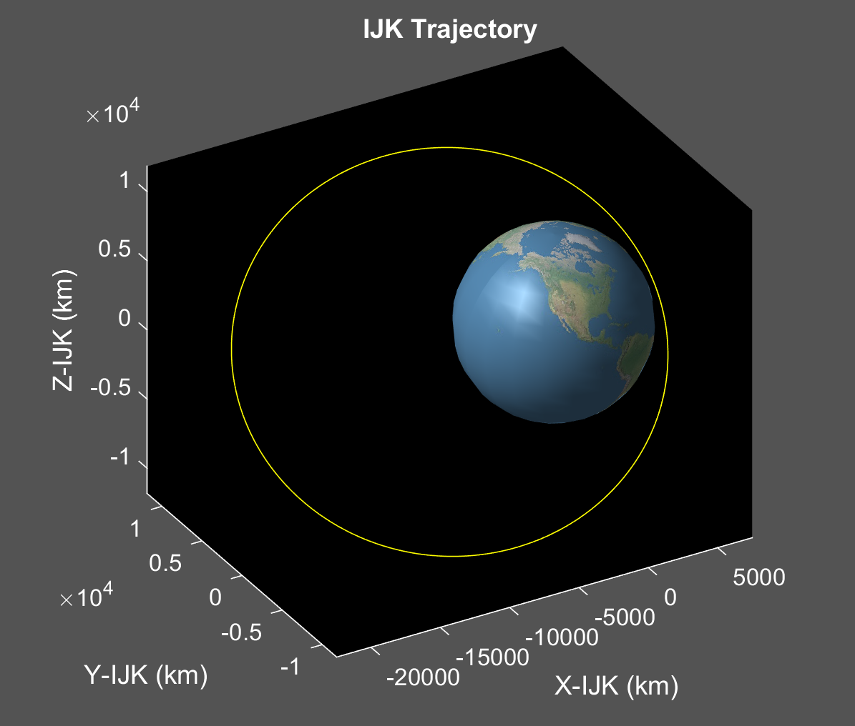
e) [a e i ω Ω ν] = [15000 0.5 50 0 0 0]
High eccentricity seen by closely spaced dots at apogee and farther dots at perigee
Inclination same as (a) and (c), provides similar coverage

Slide 11
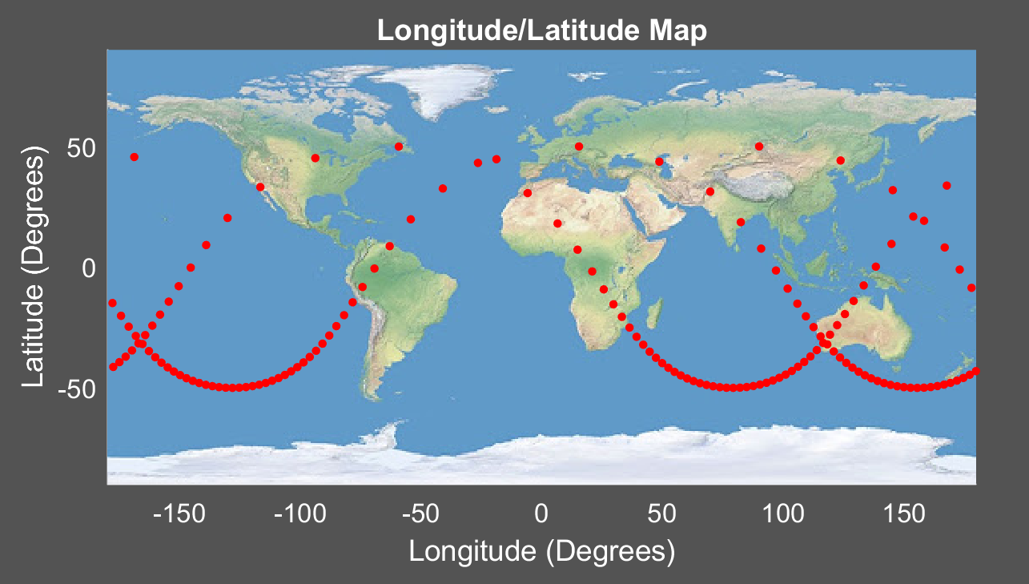
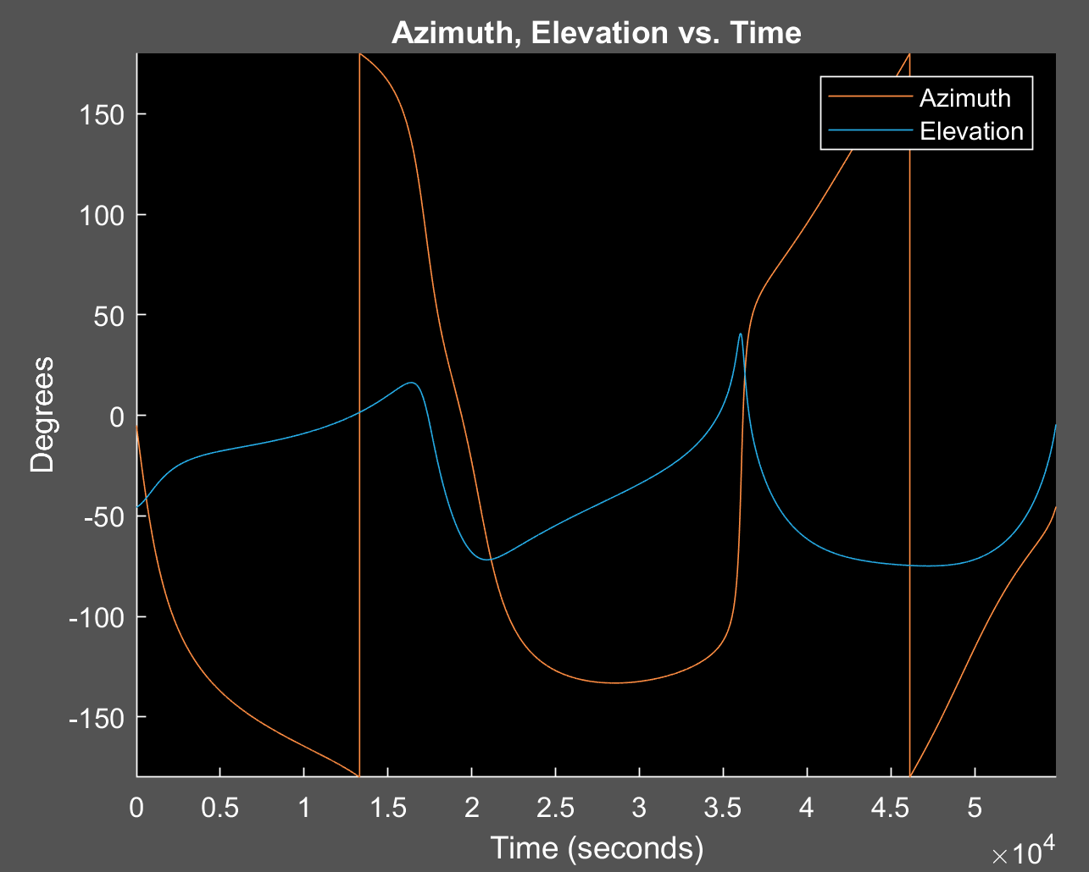
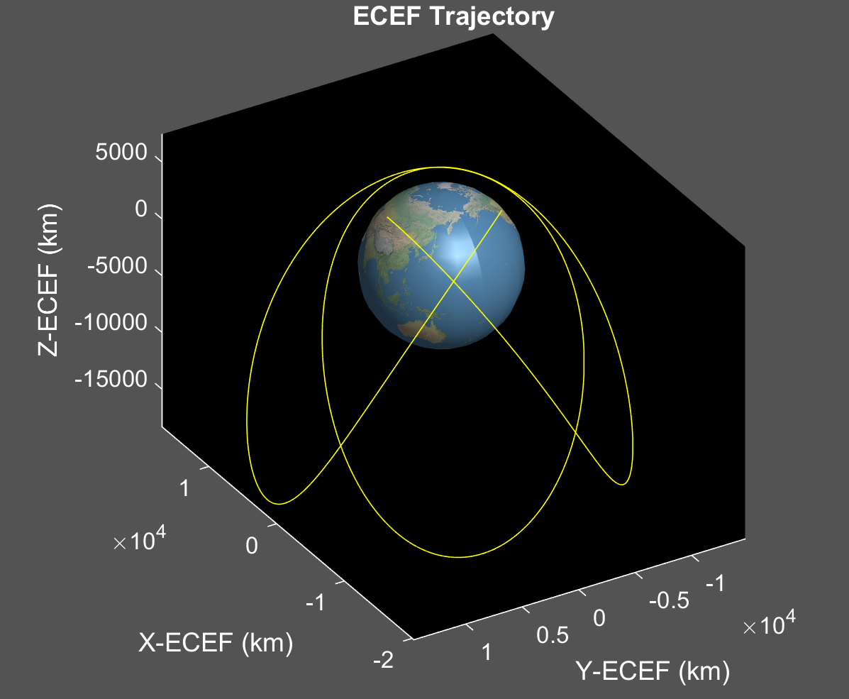
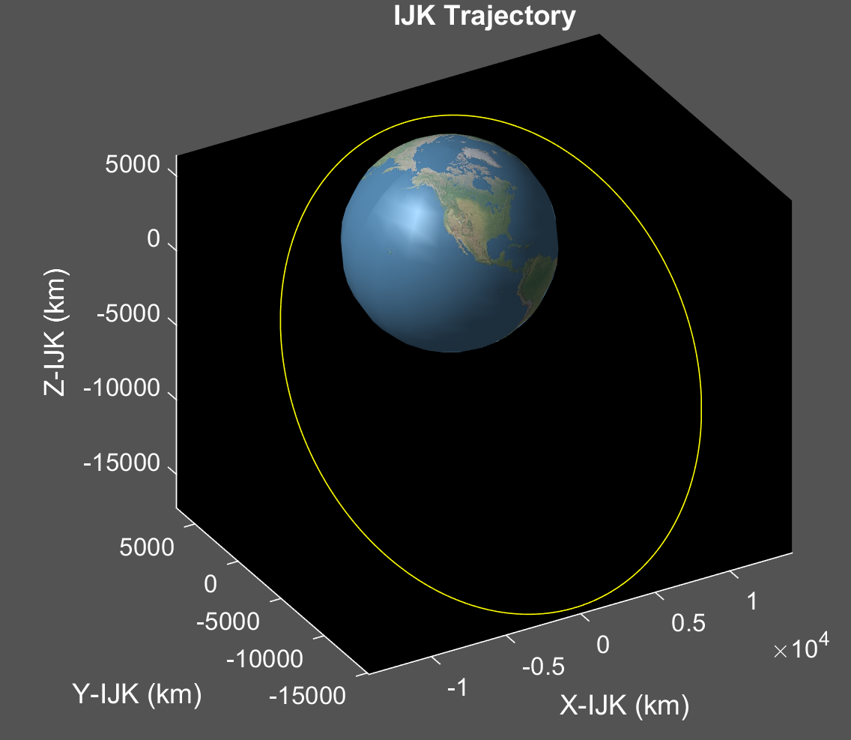
f) [a e i ω Ω ν] = [15000 0.5 50 90 0 0]
LAN shifted by 90 degrees from (e)
Slow part of ground track rotated 90 degrees counter-clockwise, now in southern hemisphere
50-degree inclination provides similar latitude ranges to previous problems
High eccentricity provides variation in ground track speed

Slide 12
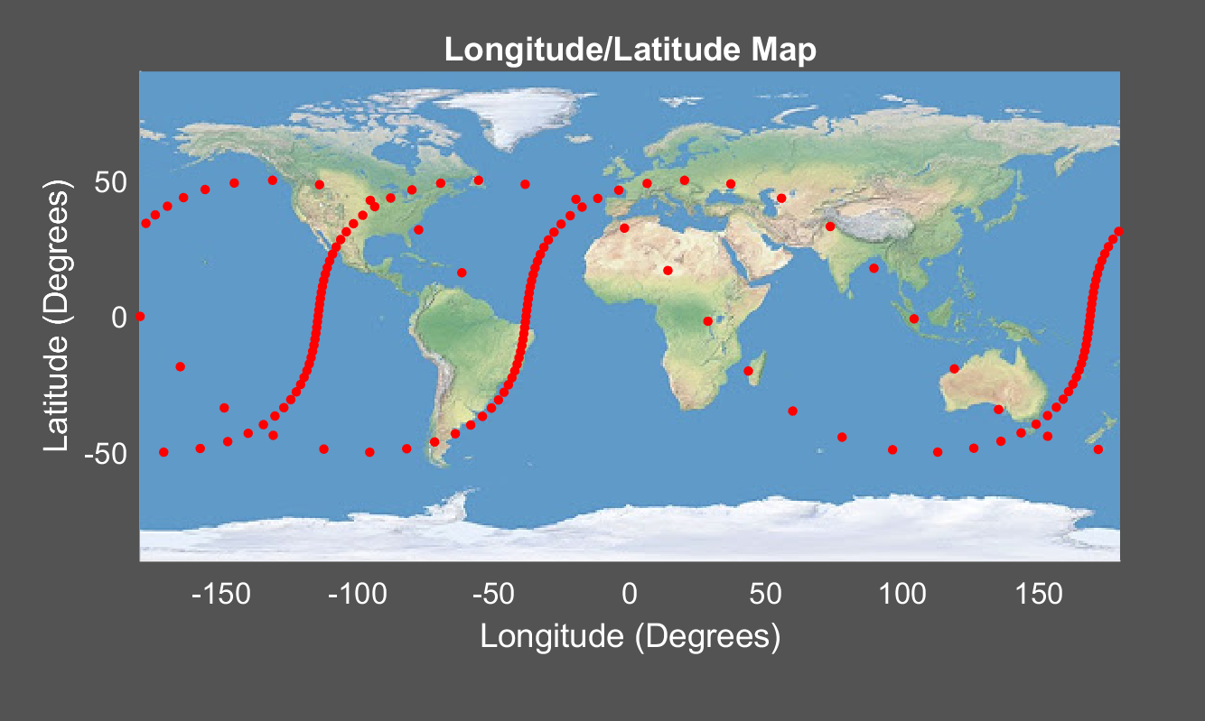
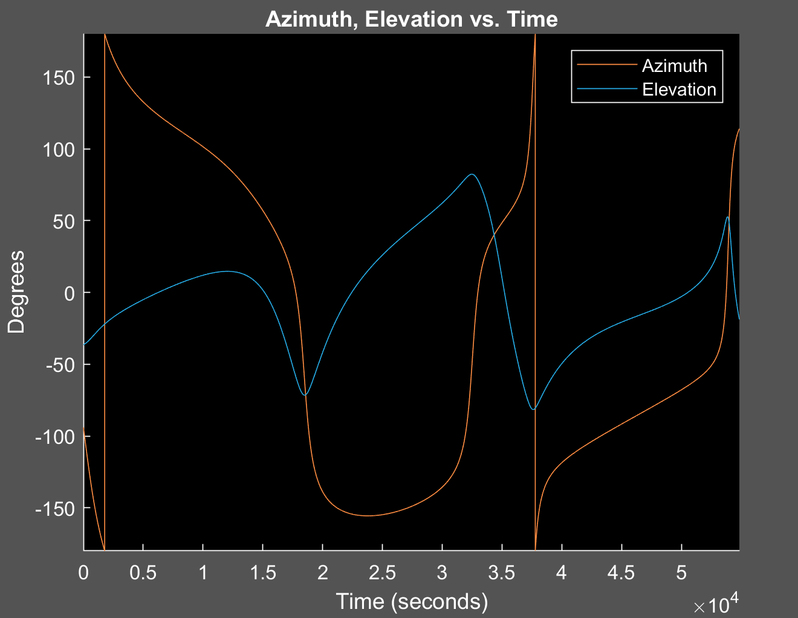
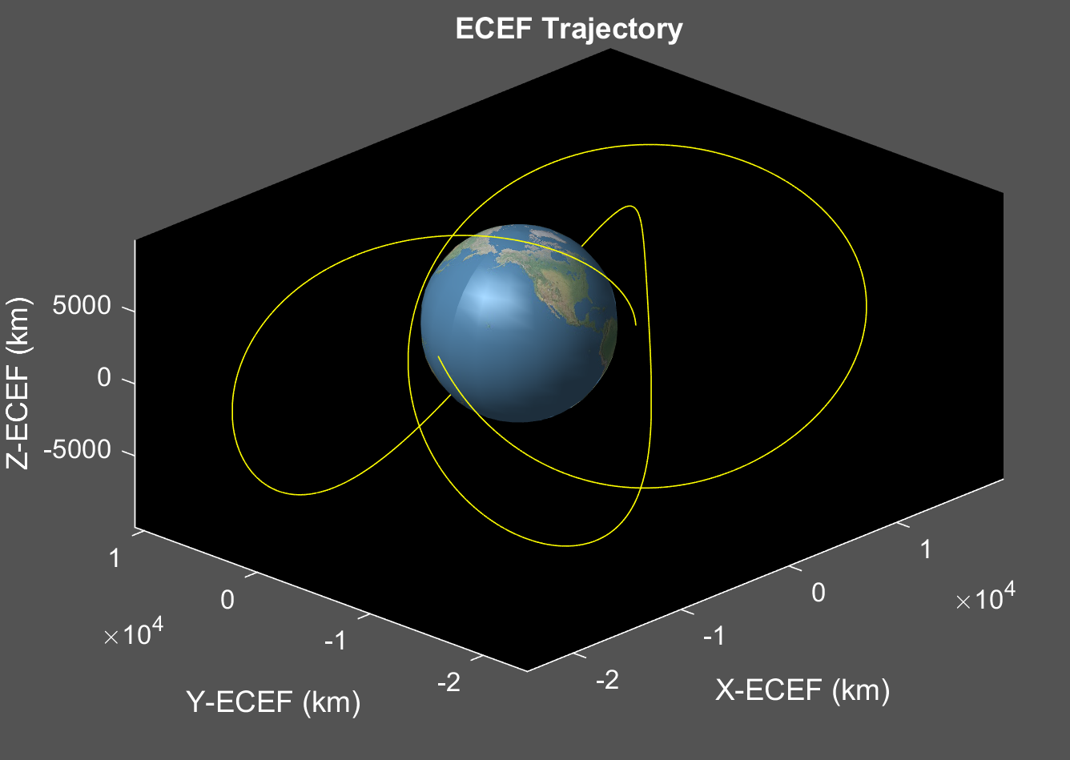
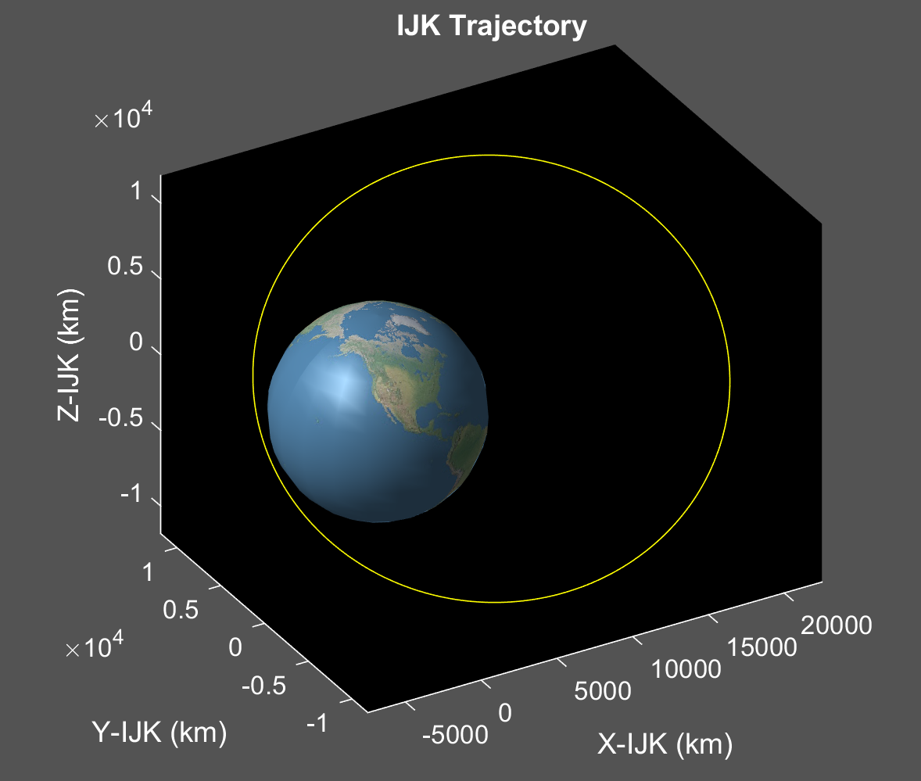
g) [a e i ω Ω ν] = [15000 0.5 50 180 0 0]
LAN shifted by 90 degrees again
Results in 90-degree shift counter-clockwise for ground track
Pattern is a reflection of (e)
Latitude range, and ground track step variation similar to (e) and (f)

Slide 13
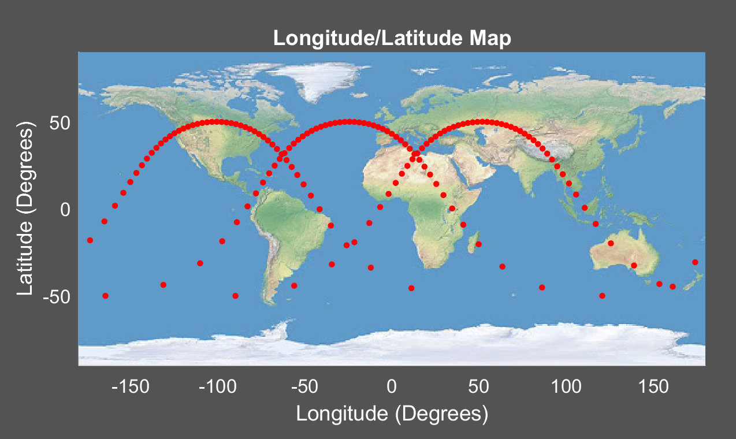
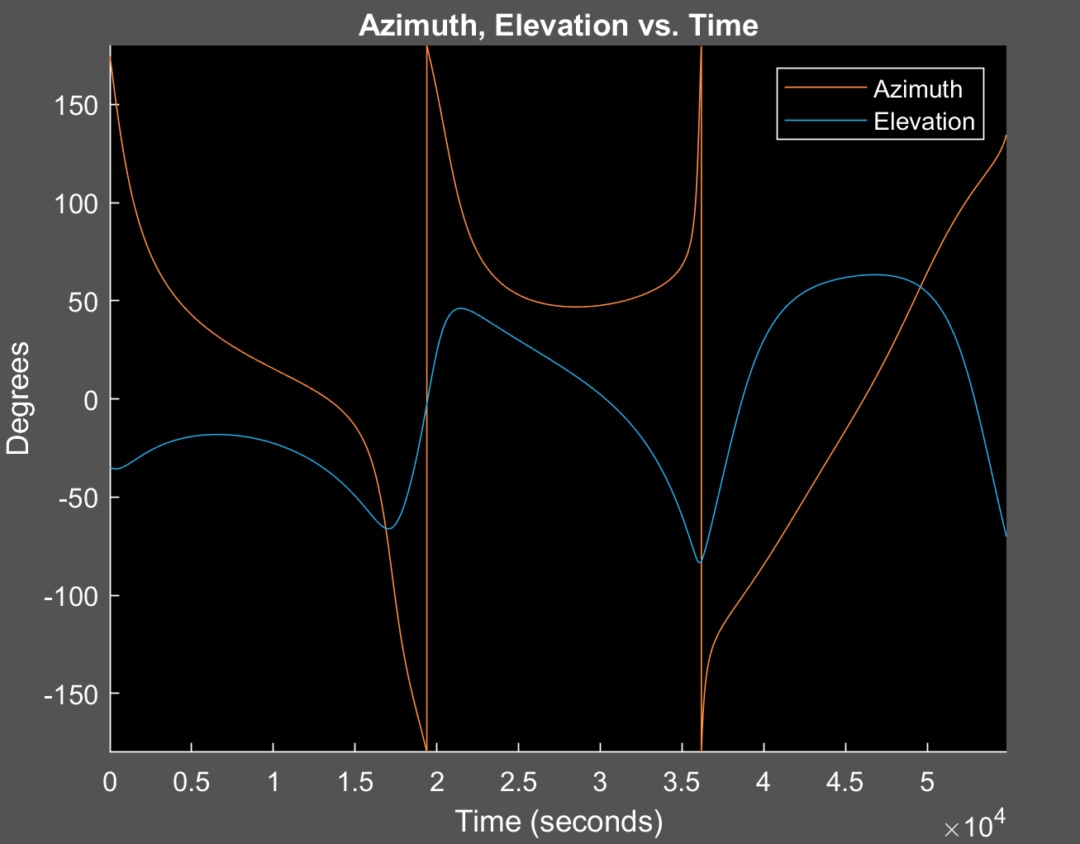
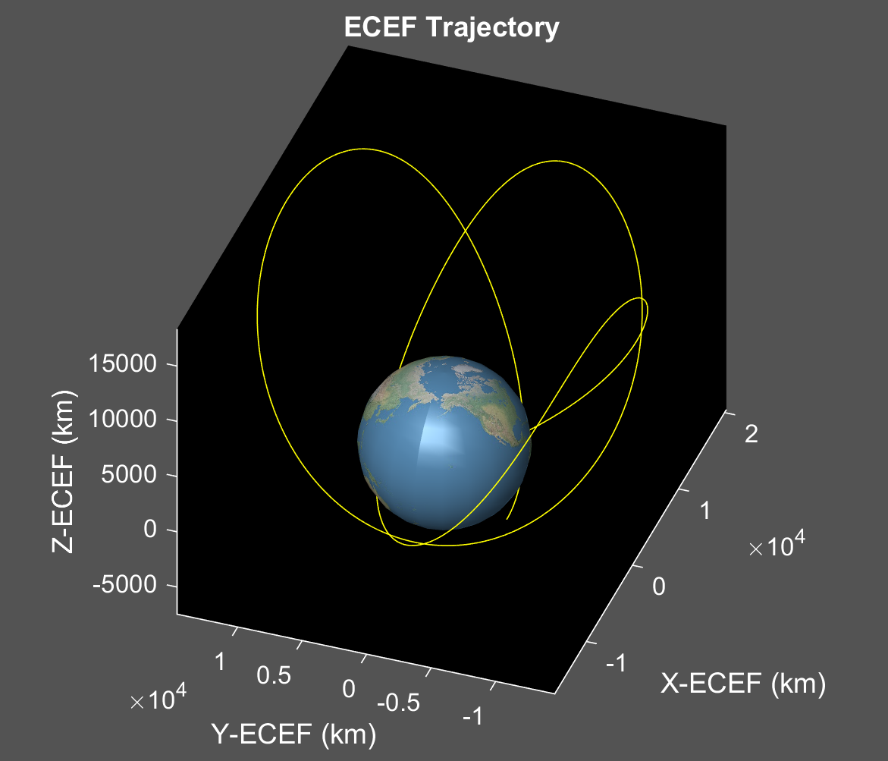
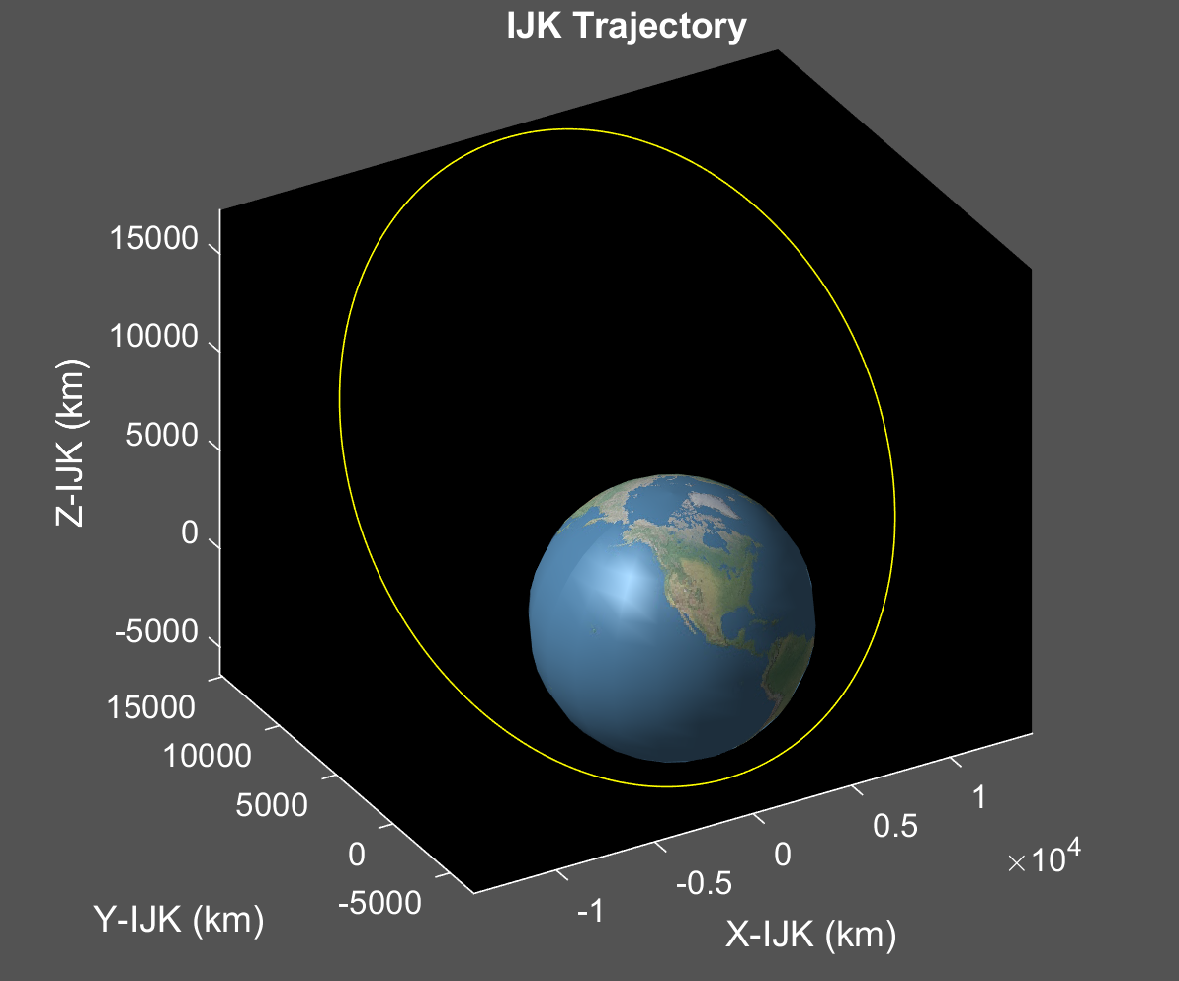
h) [a e i ω Ω ν] = [15000 0. 5 50 270 0 0]
LAN shifted by 90 degrees again
Apogee now in the northern hemisphere
90-degree rotation counter-clockwise
Reflection of (f)
Provides good coverage for population centers across globe
Ground track step variation and Latitude ranges similar to previous scenarios

Slide 14
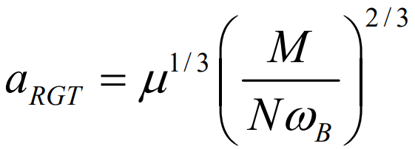
Repeat Ground Track Problem
To determine orbit, loop through M and N until semi-major axis is within the bounds specified [6678, 6683] km
Semi-Major Axis: 6680.256342908875 km
Earth Revolutions (M): 7
Spacecraft Orbits (N): 111
Time of repeat period = N*Orbit Period = 111*5433.8 s = 6.981 days

Slide 15
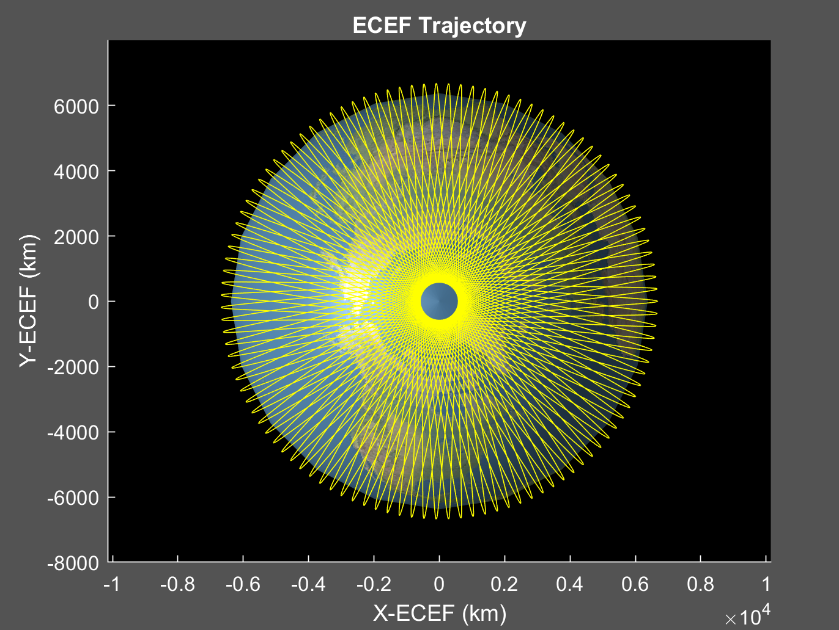
Repeat Ground Track Problem
This trajectory covers the surface of the earth well, due to its high inclination
Useful if the satellite requires global coverage to achieve its mission
Orbits are equally spaced for this repeat ground track
Angle between orbits = 360/N = 3.2432 deg
Required field of view = 3.2432/2
= 1.6216 degrees

